Slide 1

Data Science
Shiva Sir
www.shivaconceptsolution.com
0731-4069788

Slide 2
What is data science
Data science is a way to try and discover hidden patterns in raw data. To achieve this goal, it makes use of several algorithms, machine learning(ML) principles, and scientific methods. The insights it retrieves from data lie in forms structured and unstructured. So in a way, this is like data mining. Data science encompasses all- data analysis, statistics, and machine learning. With more practices being labelled into data science

Slide 3
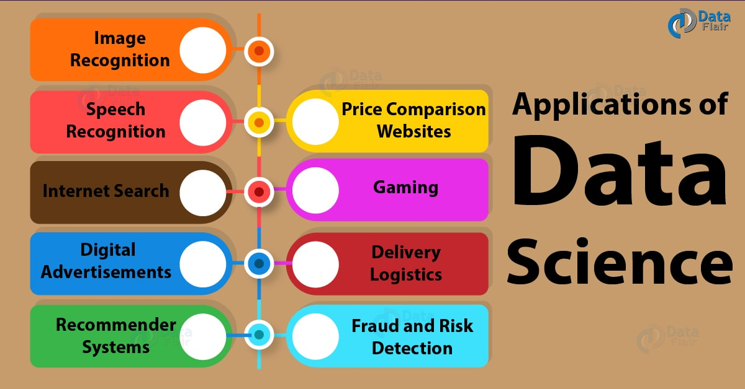

Slide 4
Data Analysis
Text Analysis
Statistical Analysis
Diagnostic Analysis
Predictive Analysis
Prescriptive Analysis

Slide 5
Text Analysis
Text Analysis is also referred to as Data Mining. It is a method to discover a pattern in large data sets using databases or data mining tools. It used to transform raw data into business information. Business Intelligence tools are present in the market which is used to take strategic business decisions. Overall it offers a way to extract and examine data and deriving patterns and finally interpretation of the data.

Slide 6
Statistical Analysis
It is used to analyze statistics data. Statistical Analysis includes collection, Analysis, interpretation, presentation, and modeling of data. It analyses a set of data or a sample of data. There are two categories of this type of Analysis - Descriptive Analysis and Inferential Analysis.

Slide 7
Descriptive Analysis
analyses complete data or a sample of summarized numerical data. It shows mean and deviation for continuous data whereas percentage and frequency for categorical data.

Slide 8
Inferential Analysis
analyses sample from complete data. In this type of Analysis, you can find different conclusions from the same data by selecting different samples.

Slide 9
Diagnostic Analysis
Diagnostic Analysis shows "Why did it happen?" by finding the cause from the insight found in Statistical Analysis. This Analysis is useful to identify behavior patterns of data. If a new problem arrives in your business process, then you can look into this Analysis to find similar patterns of that problem. And it may have chances to use similar prescriptions for the new problems.

Slide 10
Predictive Analysis
Predictive Analysis shows "what is likely to happen" by using previous data. The simplest example is like if last year I bought two dresses based on my savings and if this year my salary is increasing double then I can buy four dresses. But of course it's not easy like this because you have to think about other circumstances like chances of prices of clothes is increased this year or maybe instead of dresses you want to buy a new bike, or you need to buy a house!
So here, this Analysis makes predictions about future outcomes based on current or past data. Forecasting is just an estimate. Its accuracy is based on how much detailed information you have and how much you dig in it.

Slide 11
Prescriptive Analysis
Prescriptive Analysis combines the insight from all previous Analysis to determine which action to take in a current problem or decision. Most data-driven companies are utilizing Prescriptive Analysis because predictive and descriptive Analysis are not enough to improve data performance. Based on current situations and problems, they analyze the data and make decisions.

Slide 12
Data Analysis Process
Data Requirement Gathering
Data Collection
Data Cleaning
Data Analysis
Data Interpretation
Data Visualization

Slide 13
Data Requirement Gathering
First of all, you have to think about why do you want to do this data analysis? All you need to find out the purpose or aim of doing the Analysis. You have to decide which type of data analysis you wanted to do! In this phase, you have to decide what to analyze and how to measure it, you have to understand why you are investigating and what measures you have to use to do this Analysis.

Slide 14
Data Collection
After requirement gathering, you will get a clear idea about what things you have to measure and what should be your findings. Now it's time to collect your data based on requirements. Once you collect your data, remember that the collected data must be processed or organized for Analysis. As you collected data from various sources, you must have to keep a log with a collection date and source of the data.

Slide 15
Data Cleaning
Now whatever data is collected may not be useful or irrelevant to your aim of Analysis, hence it should be cleaned. The data which is collected may contain duplicate records, white spaces or errors. The data should be cleaned and error free. This phase must be done before Analysis because based on data cleaning, your output of Analysis will be closer to your expected outcome.

Slide 16
Data Analysis
Once the data is collected, cleaned, and processed, it is ready for Analysis. As you manipulate data, you may find you have the exact information you need, or you might need to collect more data. During this phase, you can use data analysis tools and software which will help you to understand, interpret, and derive conclusions based on the requirements.

Slide 17
Data Interpretation
After analyzing your data, it's finally time to interpret your results. You can choose the way to express or communicate your data analysis either you can use simply in words or maybe a table or chart. Then use the results of your data analysis process to decide your best course of action.

Slide 18
Data Visualization
Data visualization is very common in your day to day life; they often appear in the form of charts and graphs. In other words, data shown graphically so that it will be easier for the human brain to understand and process it. Data visualization often used to discover unknown facts and trends. By observing relationships and comparing datasets, you can find a way to find out meaningful information.

Slide 19
Library of DS
NumPy
SCIPY
Matplotlib
Pandas

Slide 20
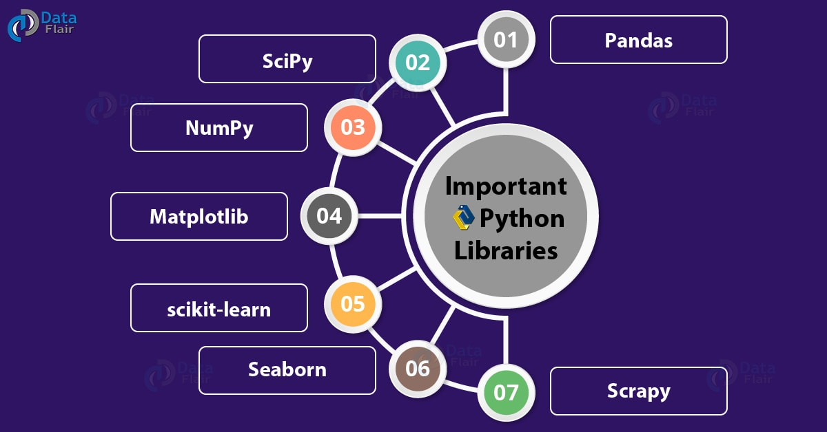
Library

Slide 21
Numpy Definition
NumPy is an open source library available in Python that aids in mathematical, scientific, engineering, and data science programming.
NumPy is an incredible library to perform mathematical and statistical operations. It works perfectly well for multi-dimensional arrays and matrices multiplication

Slide 22
How to install numpy
Python –m pip install numpy

Slide 23
What is Python Numpy Array?
NumPy arrays are a bit like Python lists, but still very much different at the same time. For those of you who are new to the topic, let’s clarify what it exactly is and what it’s good for.
As the name kind of gives away, a NumPy array is a central data structure of the numpy library. The library’s name is actually short for "Numeric Python" or "Numerical Python".

Slide 24
Shape of Array
import numpy as np
a = np.array([1,2,3])
print(a.shape)
print(a.dtype)

Slide 25
2 Dimension Array
You can add a dimension with a ","coma
Note that it has to be within the bracket []
### 2 dimension
c = np.array([(1,2,3), (4,5,6)])
print(c.shape) (2, 3)

Slide 26
3 Dimension Array
d = np.array([ [[1, 2,3], [4, 5, 6]], [[7, 8,9], [10, 11, 12]] ])
print(d.shape)
(2, 2, 3)

Slide 27
Numpy matrix
import numpy as np
A = np.matrix(np.ones((4,4)))

Slide 28
NumPy Statistical Functions with Example
Statistical function
Numpy is equipped with the robust statistical function as listed below
FunctionNumpy
Min np.min()
Max np.max()
Mean np.mean()
Median np.median()

Slide 29
import numpy as np
normal_array = np.random.normal(5, 0.5, 10) print(normal_array)
print(np.min(normal_array)) ### Max print(np.max(normal_array)) ### Mean print(np.mean(normal_array)) ### Median print(np.median(normal_array)) ### Sd print(np.std(normal_array))

Slide 30
numpy.dot(): Dot Product in Python using Numpy
x,y: Input arrays. x and y both should be 1-D or 2-D for the function to work
out: This is the output argument.For 1-D array scalar is returned. Other wise ndarray
Example:
## Linear algebra ### Dot product: product of two arrays
f = np.array([1,2])
g = np.array([4,5]) ### 1*4+2*5
np.dot(f, g)

Slide 31
NumPy Matrix Multiplication with np.matmul() Example
### Matmul: matruc product of two arrays
h = [[1,2],[3,4]]
i = [[5,6],[7,8]] ### 1*5+2*7 = 19 np.matmul(h, i)

Slide 32
Determinant
Last but not least, if you need to compute the determinant, you can use np.linalg.det(). Note that numpy takes care of the dimension.
## Determinant 2*2 matrix ### 5*8-7*6np.linalg.det(i)

Slide 33
Python Matplotlib
Working across platforms, when you want to conceive publication quality figures in hardcopy formats and interactive environments, you use matplotlib. This is a library for 2-dimensional plotting with Python. Some plots it will let us build are:
Plots
Histograms
Error charts
Power spectra
Bar charts
Scatter Plots

Slide 34
Installation
python -m pip install matplotlib

Slide 35
Draw plot
import numpy as np
import matplotlib.pyplot as plt
x = np.arange(0, 3 * np.pi, 0.1)
y = np.sin(x)
plt.title("sine wave form")
plt.plot(x, y)
plt.show()

